Slide 1
Bioreactor Model Simulation Using Simulink
CH 331: Process Control Lab
Purab Gupta 2022chb1055
Vedang Sakpal 2022chb1056
Sayed Musaraf 2022chb1057

Slide 2
Problem Statement
The bioreactor system involves a fermenter operated at constant volume, where a single rate-limiting substrate promotes biomass growth and fermentation.
The system follows nonlinear dynamics due to inhibition effects from both the substrate and product.
The objective is to simulate and analyze the behavior of biomass, substrate, and product concentrations under open-loop conditions using Simulink.

Slide 3
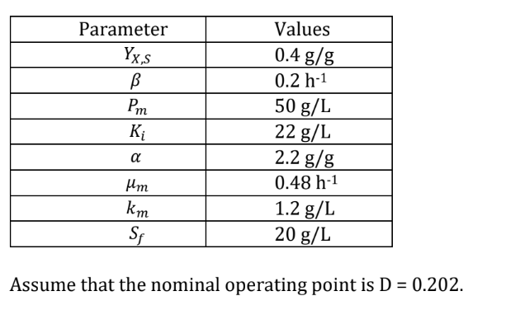
System Variables
Constants:
Manipulated Input: Dilution Rate ()
Disturbance Variables: Substrate (S)
Controlled Variables: Biomass (), Product ()
Sampling Time: 1 min

Slide 4
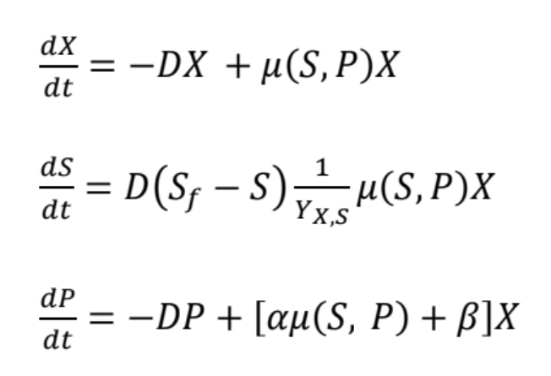
Governing Equations

Slide 5
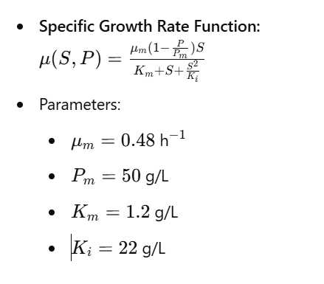
Growth Rate Model

Slide 6
Key Aspects of the Problem
Nonlinear system due to complex growth rate dependence on substrate and product.
System involves transient and steady-state responses.
Open-loop simulation performed in Simulink to observe process behavior under step changes.
Comparison of nonlinear and linearized system responses.

Slide 7
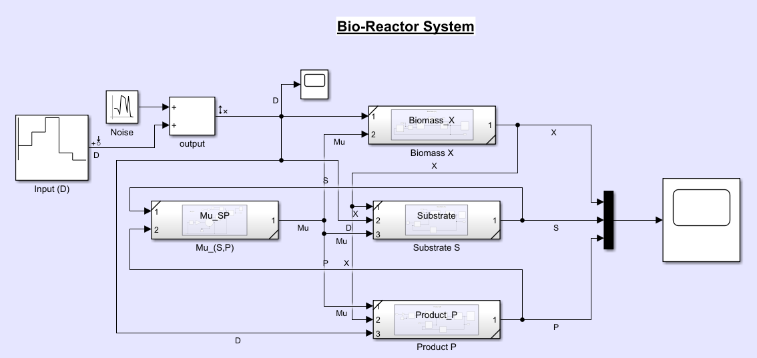
Simulink Model of Nonlinear Bioreactor

Slide 8
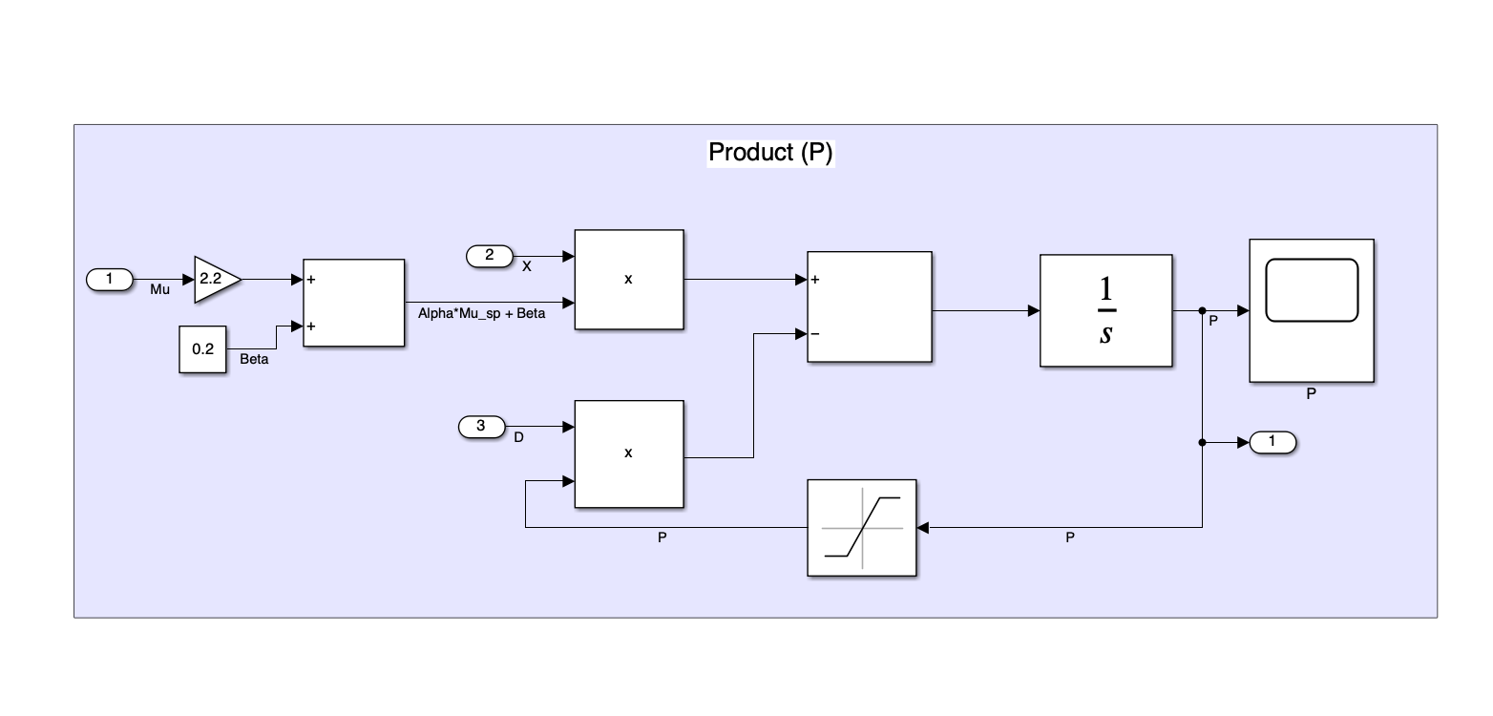
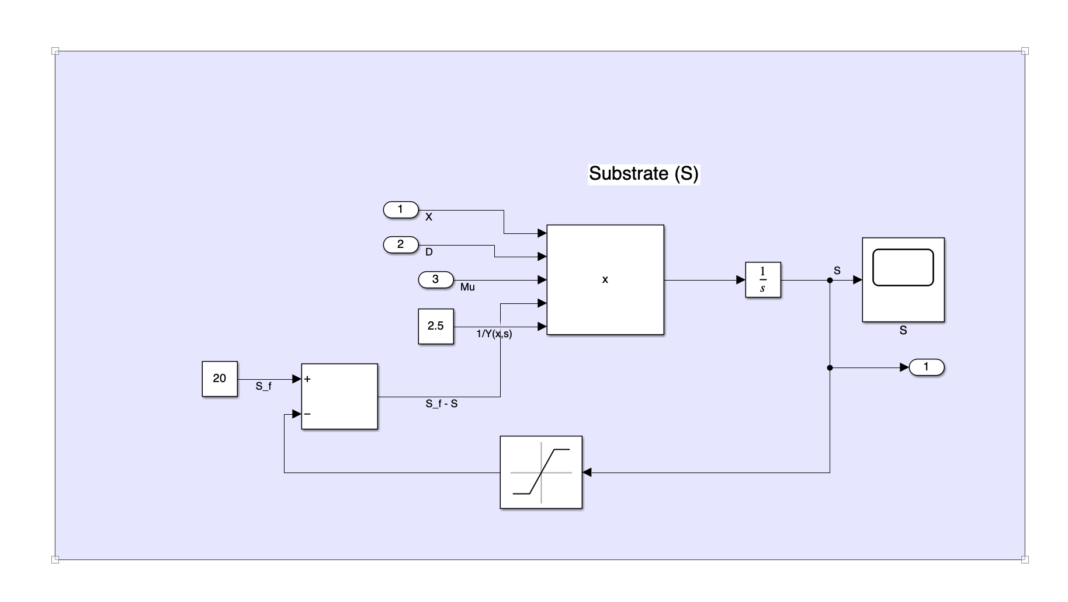
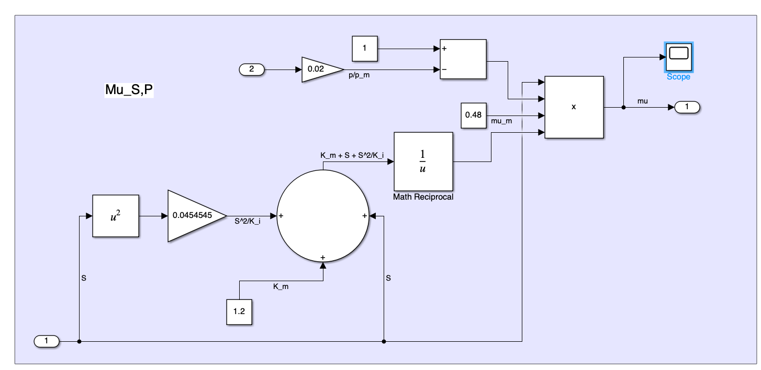

Slide 9
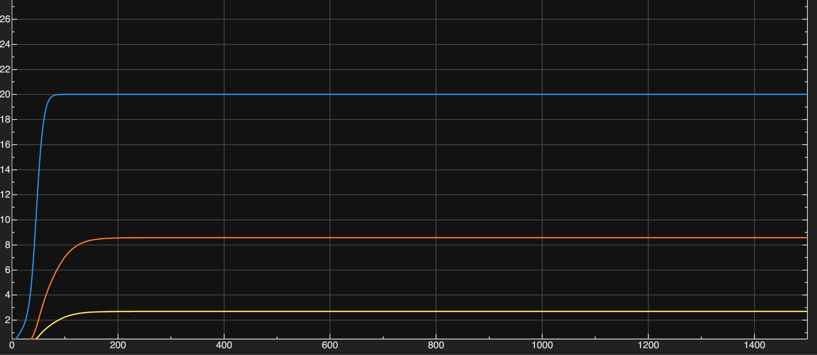
Steady State - Non-linear System (without noise)
concentration
substrate
Substrate: S≈19.999 g/L
Biomass: X≈2.6855 g/L
Product: P≈ 8.5670 g/L
Product
Biomass
Time

Slide 10
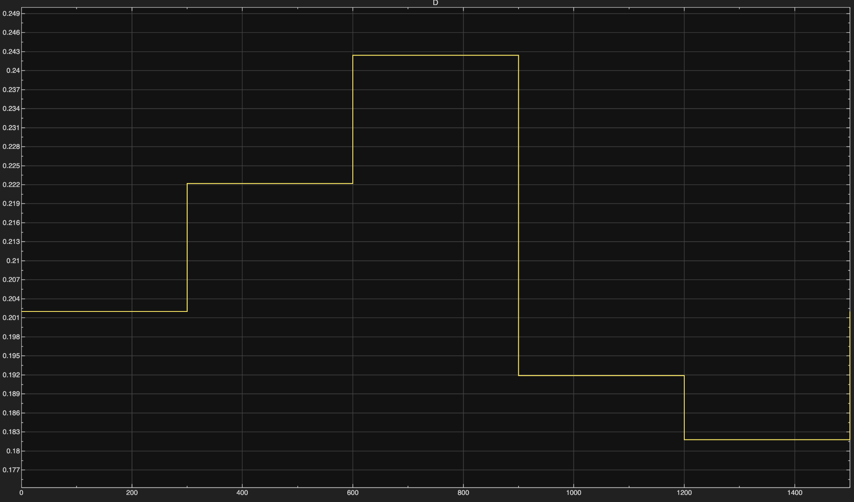
Input step change
Step change in time stamps of 300 min
0.202
0.2222
0.2424
0.1919
0.1818

Slide 11
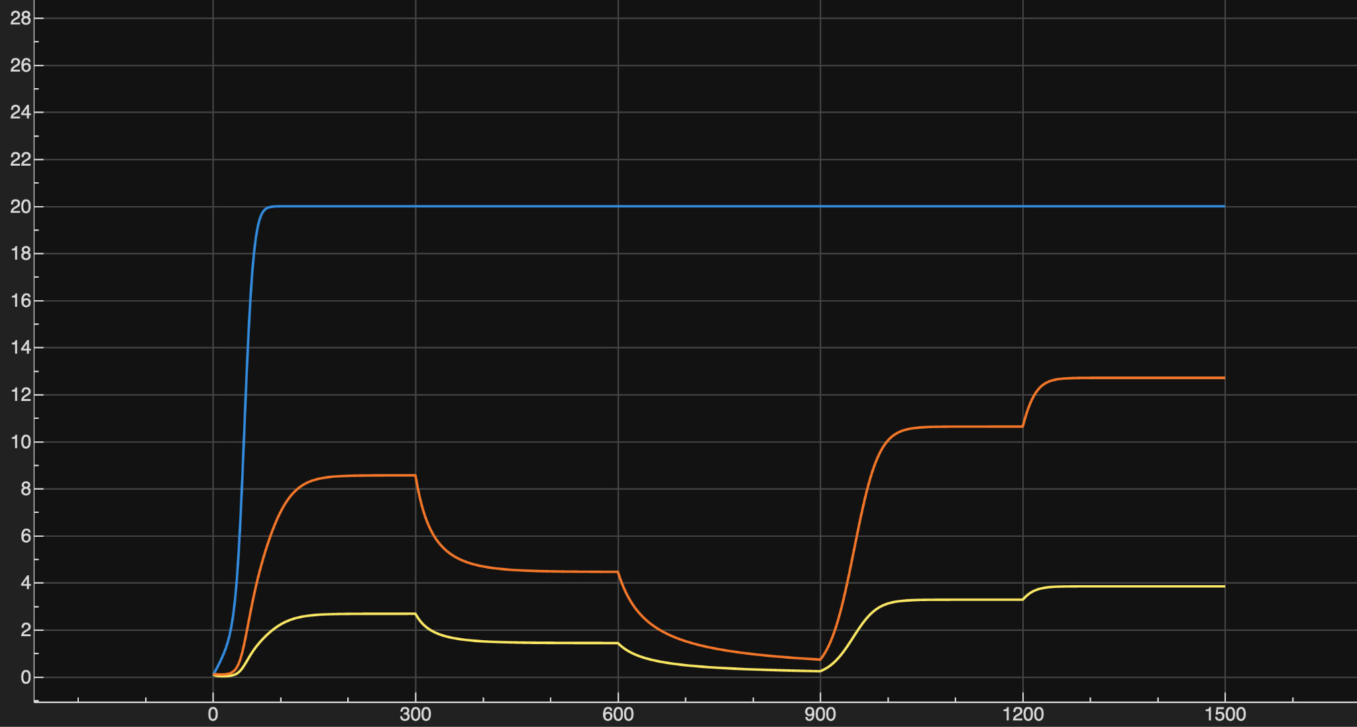
Output after step change without noise

Slide 12
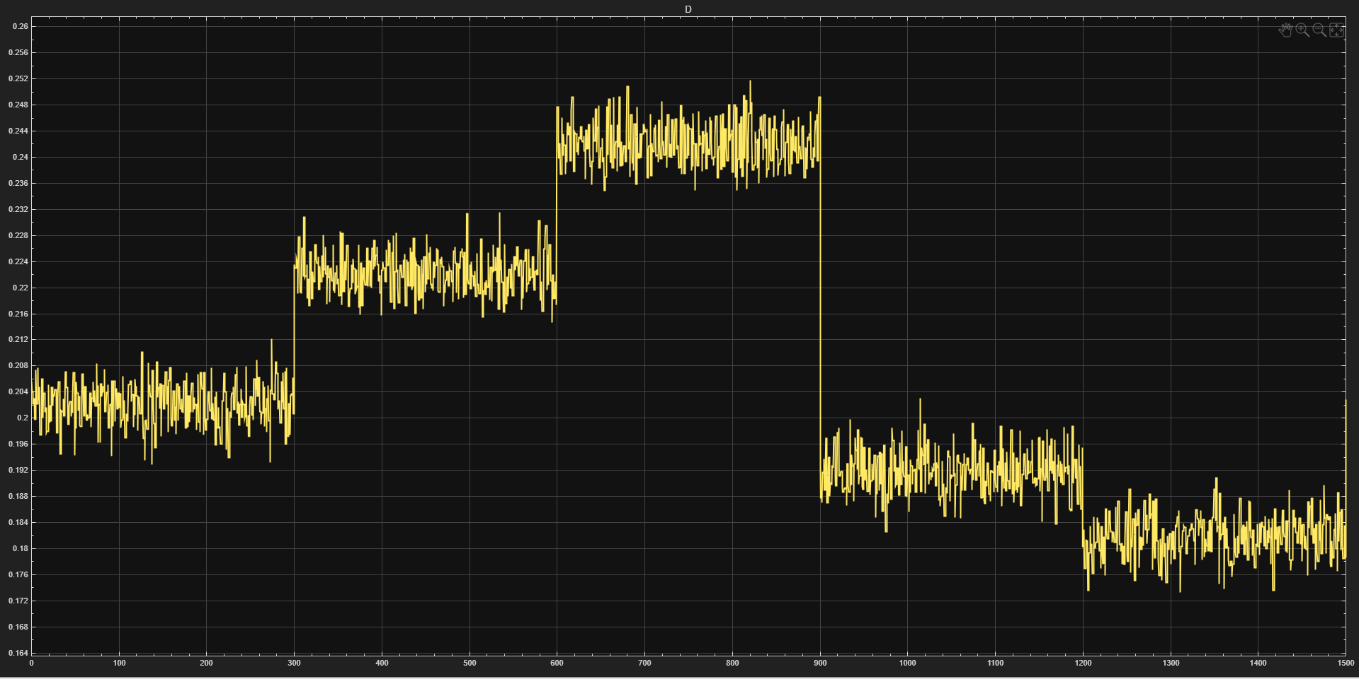
Input at step change with noise

Slide 13
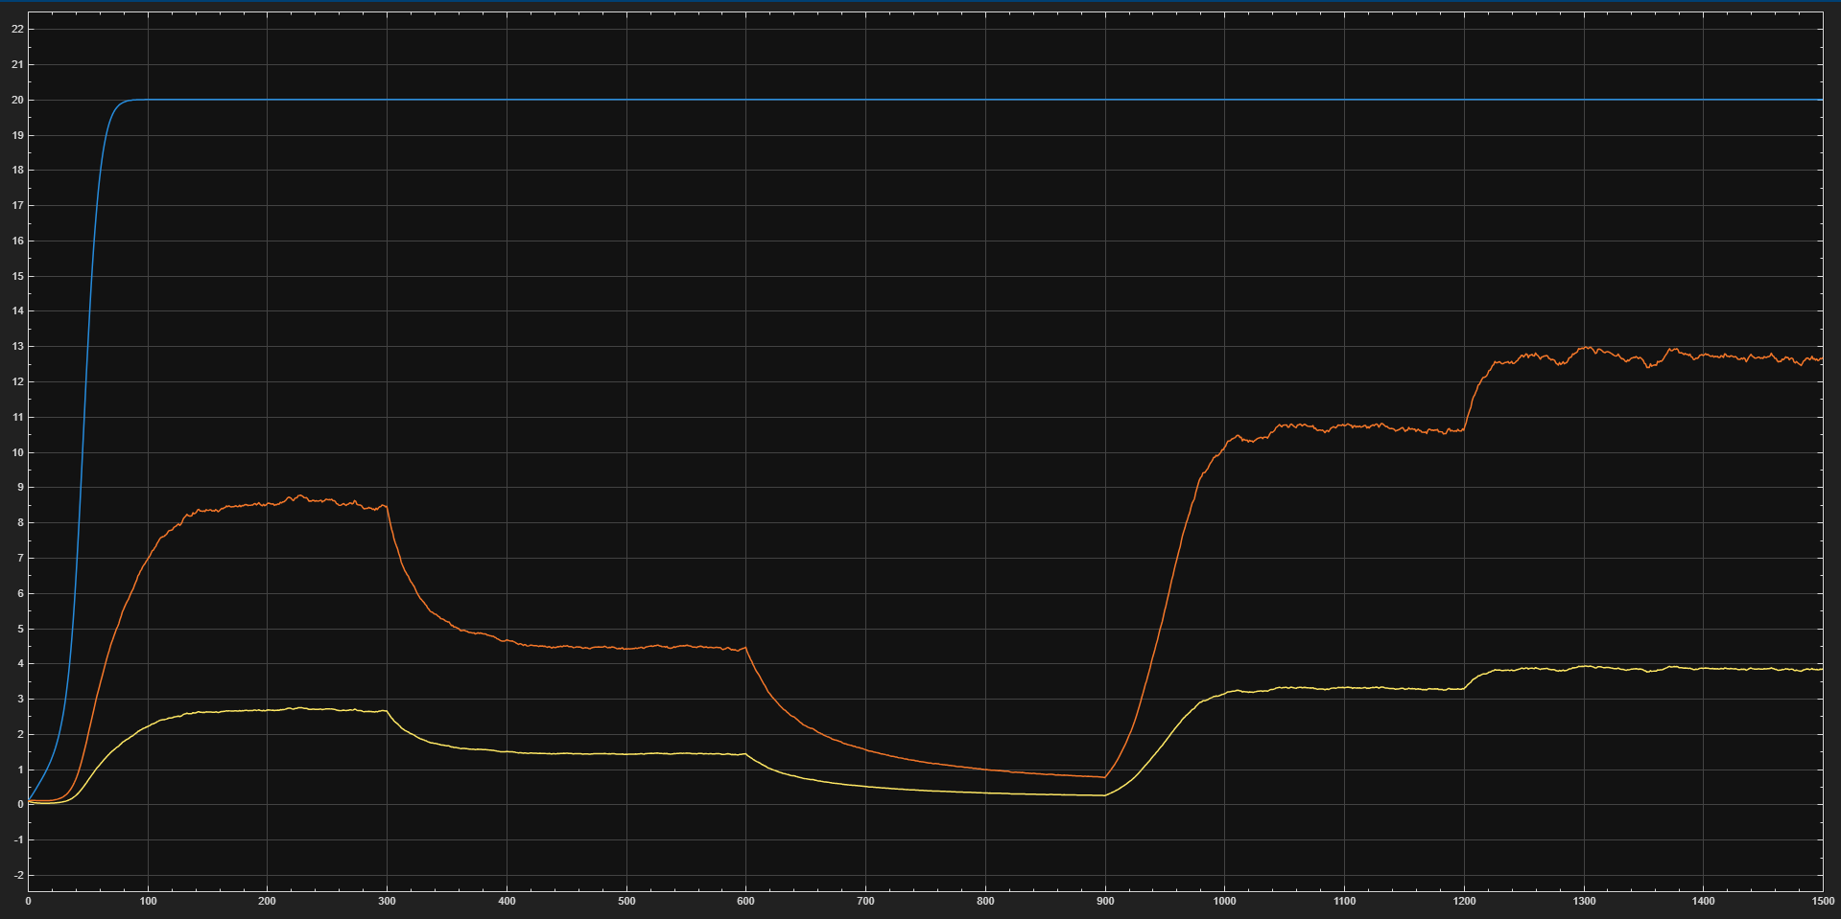
Output at step changes with noise

Slide 14
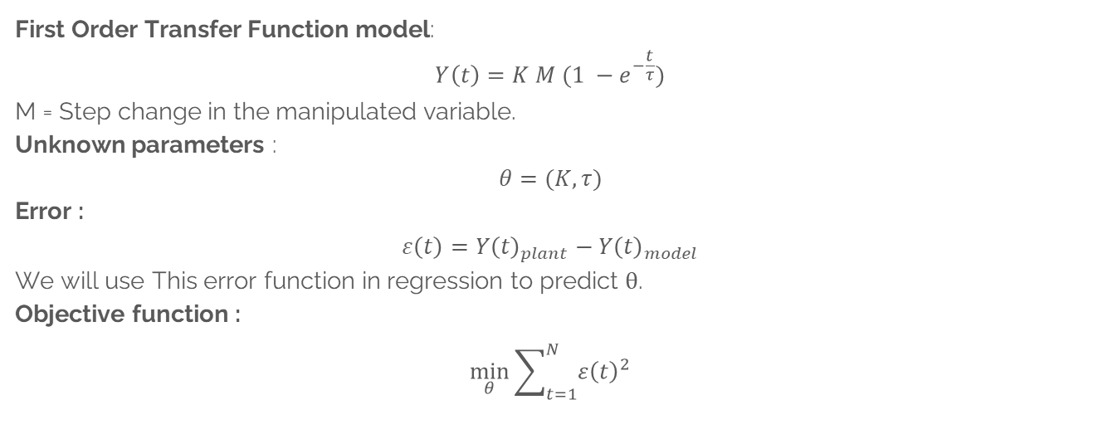
First Order Model
First Order Transfer Function model:
$$Y\left(t\right)=K M (1 −e^{−\frac{t}{τ}})$$
M = Step change in the manipulated variable.
Unknown parameters :
$$θ=(K,τ)$$
Error :
$$ε\left(t\right)=Y{\left(t\right)}_{plant}−Y{\left(t\right)}_{model}$$
We will use This error function in regression to predict θ.
Objective function :
$$\min_{θ}{\sum_{t=1}^{N}{ε{\left(t\right)}^{2}}}$$

Slide 15
Parameters
Using this objective function and using fmincon we have obtained the optimal values of the process parameter θ = (K, τ).
K = -61.0962 and τ = 23.4044 (for X)
K = -201.1259 and τ = 23.1157 (for P)
here, K = process gain and τ = time constant.
These unknown parameters are obtained using fmincon and giving initial guess of K and τ as –60 and 10 respectively for X and –200 and 10 respectively for P.

Slide 16
Validation Performance

Slide 17
Prediction Analysis
MSE (Biomass): 0.0591
RMSE (Biomass): 0.2431
MSE (Product): 0.8749
RMSE (Product): 0.9354

Slide 18
Parameters
Using this objective function and using fmincon we have obtained the optimal values of the process parameter θ = (K, τ).
K = -63.3098 and τ = 57.7610 (for X)
K = -207.2515and τ = 59.7984 (for P)
here, K = process gain and τ = time constant.
These unknown parameters are obtained using fmincon and giving initial guess of K and τ as –60 and 10 respectively for X and –200 and 10 respectively for P.

Slide 19
Validation Performance

Slide 20
Prediction Analysis
MSE (Biomass): 0.0283
RMSE (Biomass): 0.1681
MSE (Product): 0.3786
RMSE (Product): 0.6153

Slide 21
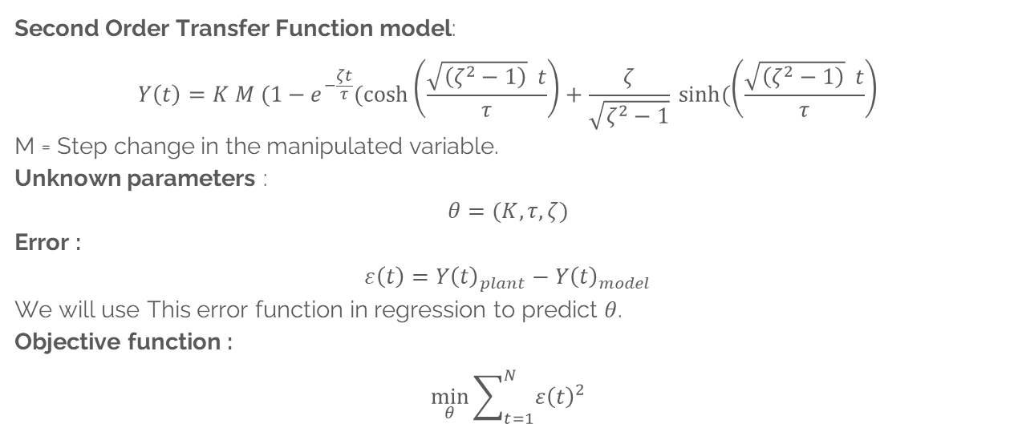
Second Order (Overdamped) Model
Second Order Transfer Function model:
$$Y\left(t\right)=K M (1−e^{−\frac{ζt}{τ}}(\cosh\left(\frac{\sqrt{\left(ζ^{2}−1\right)} t}{τ}\right)+\frac{ζ}{\sqrt{ζ^{2}−1}} sinh⁡(\left(\frac{\sqrt{\left(ζ^{2}−1\right)} t}{τ}\right)$$
M = Step change in the manipulated variable.
Unknown parameters :
$$θ=(K,τ,ζ)$$
Error :
$$ε\left(t\right)=Y{\left(t\right)}_{plant}−Y{\left(t\right)}_{model}$$
We will use This error function in regression to predict $θ$.
Objective function :
$$\min_{θ}{\sum_{t=1}^{N}{ε{\left(t\right)}^{2}}}$$

Slide 22
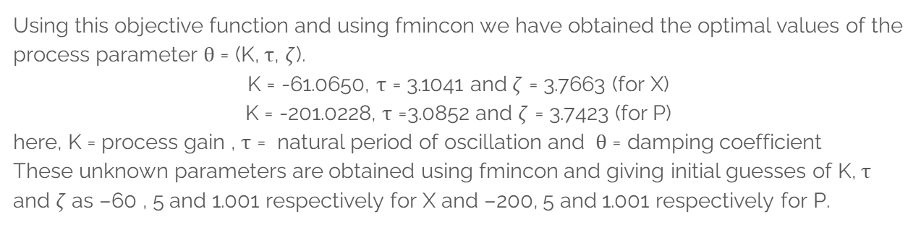
Parameters
Using this objective function and using fmincon we have obtained the optimal values of the process parameter θ = (K, τ, $ζ$).
K = -61.0650, τ = 3.1041 and $ζ$ = 3.7663 (for X)
K = -201.0228, τ =3.0852 and $ζ$ = 3.7423 (for P)
here, K = process gain , τ = natural period of oscillation and θ = damping coefficient
These unknown parameters are obtained using fmincon and giving initial guesses of K, τ and $ζ$ as –60 , 5 and 1.001 respectively for X and –200, 5 and 1.001 respectively for P.

Slide 23
Validation Performance

Slide 24
Prediction Analysis
MSE (Biomass): 0.0592
RMSE (Biomass): 0.2433
MSE (Product): 0.8755
RMSE (Product): 0.9357

Slide 25
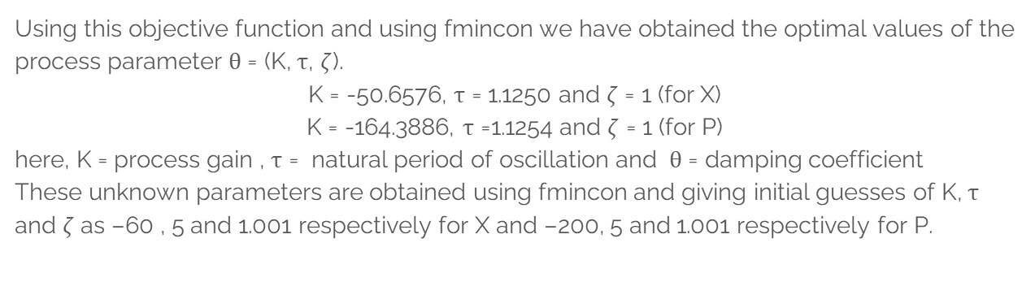
Parameters
Using this objective function and using fmincon we have obtained the optimal values of the process parameter θ = (K, τ, $ζ$).
K = -50.6576, τ = 1.1250 and $ζ$ = 1 (for X)
K = -164.3886, τ =1.1254 and $ζ$ = 1 (for P)
here, K = process gain , τ = natural period of oscillation and θ = damping coefficient
These unknown parameters are obtained using fmincon and giving initial guesses of K, τ and $ζ$ as –60 , 5 and 1.001 respectively for X and –200, 5 and 1.001 respectively for P.

Slide 26
Validation Performance

Slide 27
Prediction Analysis
MSE (Biomass): 0.0151
RMSE (Biomass): 0.1229
MSE (Product): 0.2658
RMSE (Product): 0.5156

Slide 28


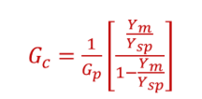

Calculation of Controller Parameters (direct synthesis method)
We have Gp for 1st order transfer function model:
Desired Closed loop transfer function assuming it to be 1st order:
For Closed loop system we have:
Substituting the values of Gp and Ym/Ysp in above, we get (For PI):

Slide 29
Identified first order model parameter Values
For X:
K_c = -0.0321
Tau_I = 48.583
Tau_d = 0.3
For P:
K_c = -0.0098
Tau_I = 41.457
Tau_d = 0.3

Slide 30
Identified second order model parameter Values
For X:
K_c = -0.052
Tau_I = 0.0992
Tau_d = 0.023
For P:
K_c = -0.017
Tau_I = 0.0866
Tau_d = 0.008877

Slide 31
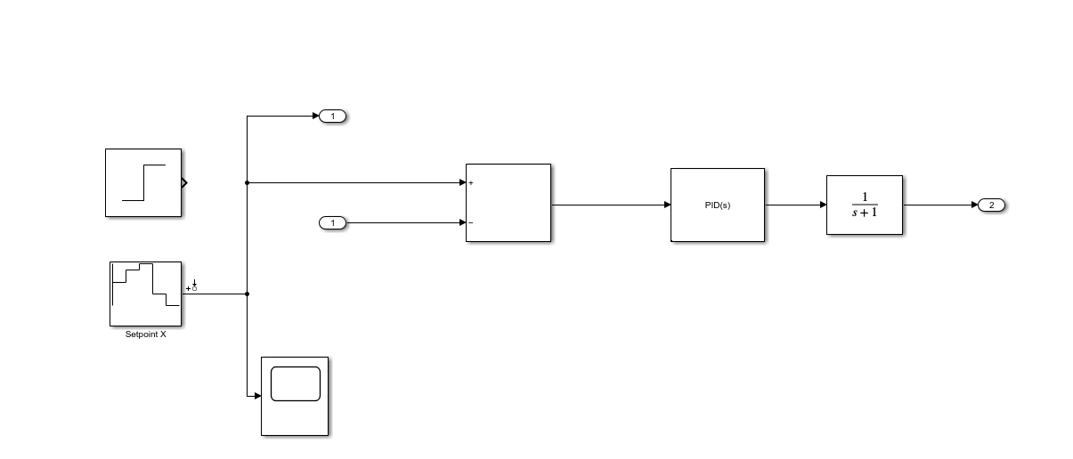
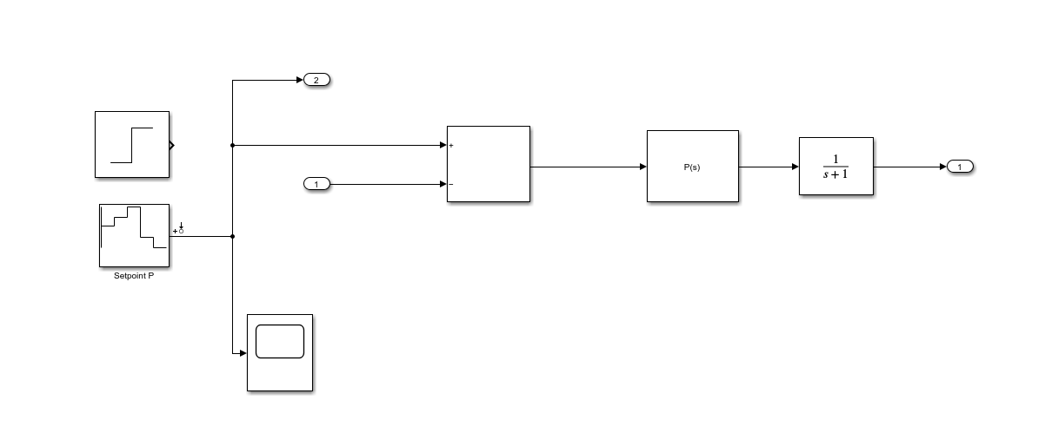
Closed loop control
Here, D is manipulated variable so it is directly given to the process as manipulated variable from PID controller.
The Substrate Sf is acting as disturbance which is also input to the process.
X and P are the output from the process which is controlled variable.

Slide 32
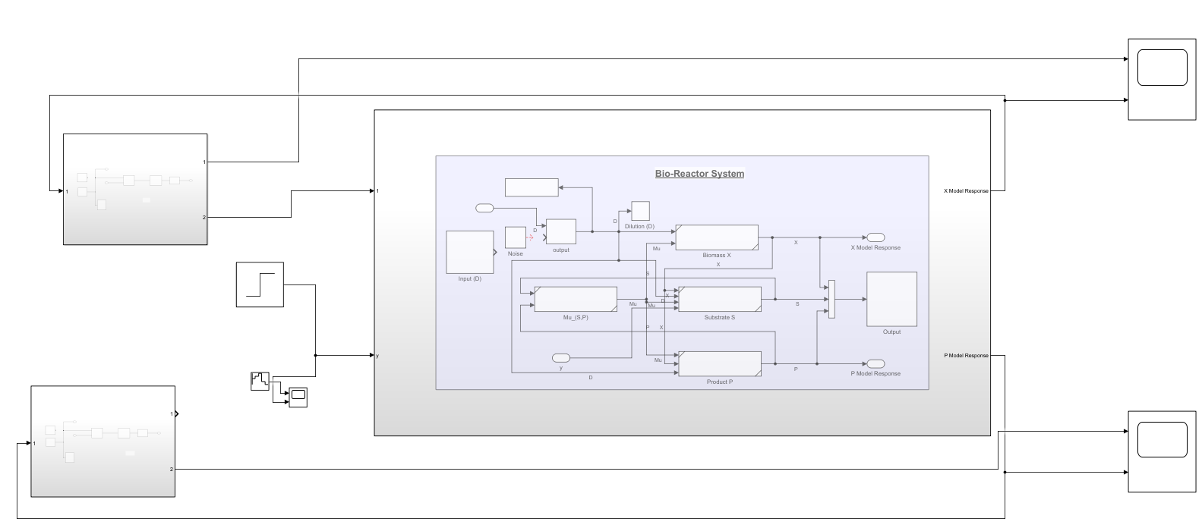
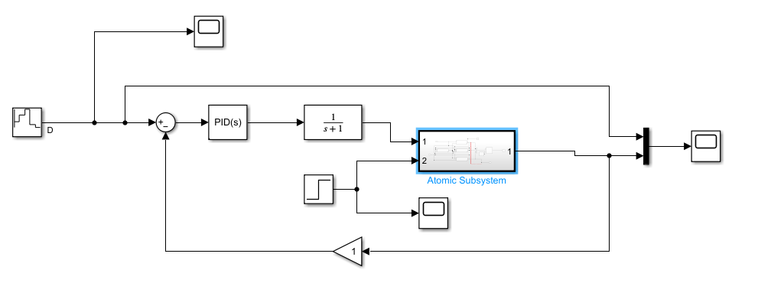
Servo Problem (Set Point Tracking)

Slide 33
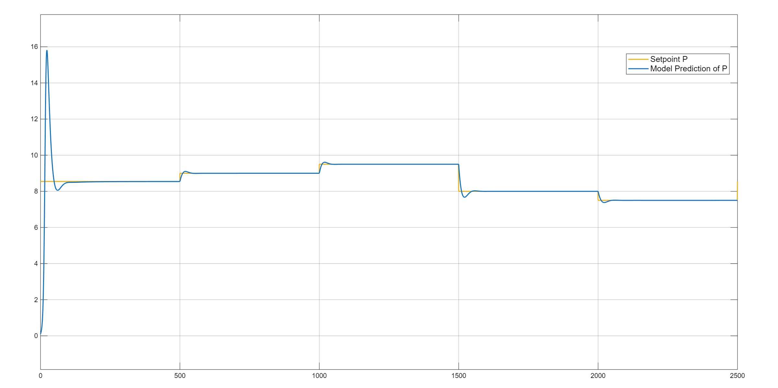
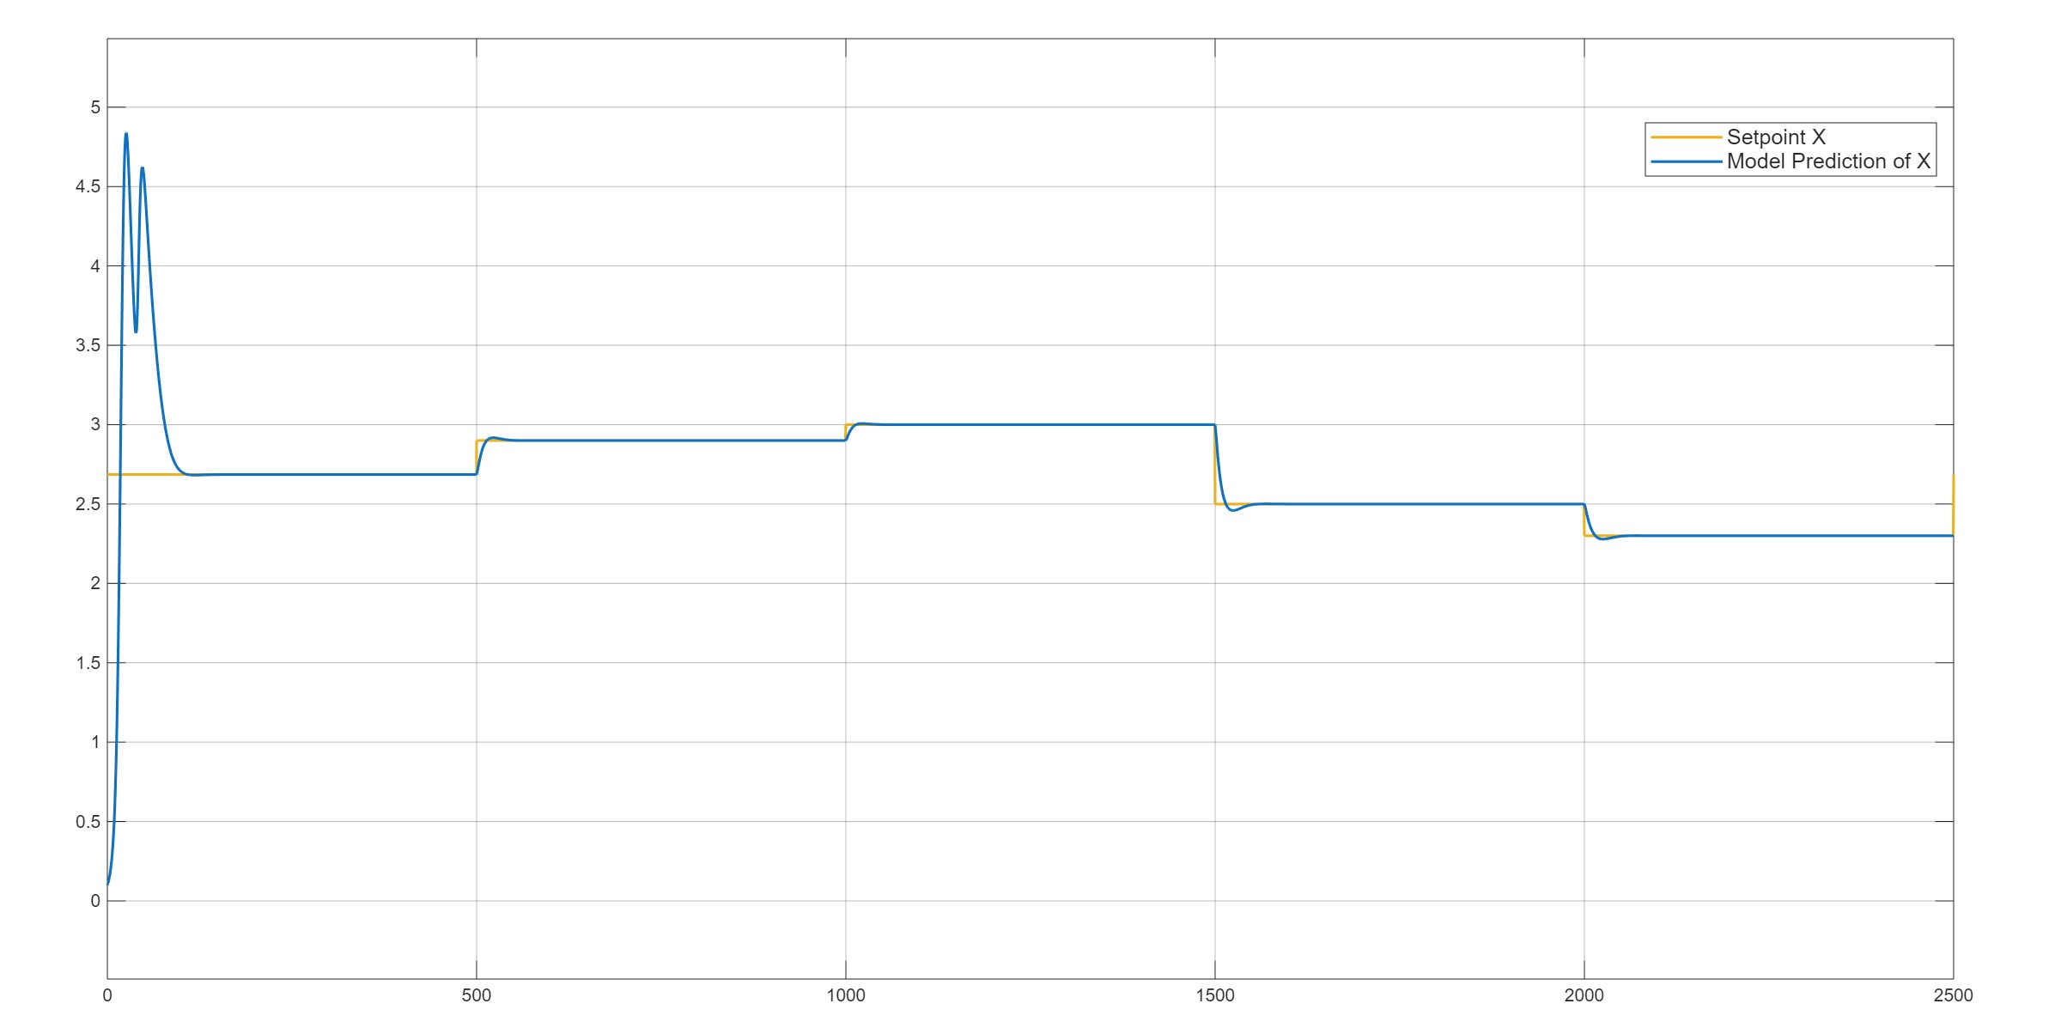
Set Point tracking-PID Controller

Slide 34
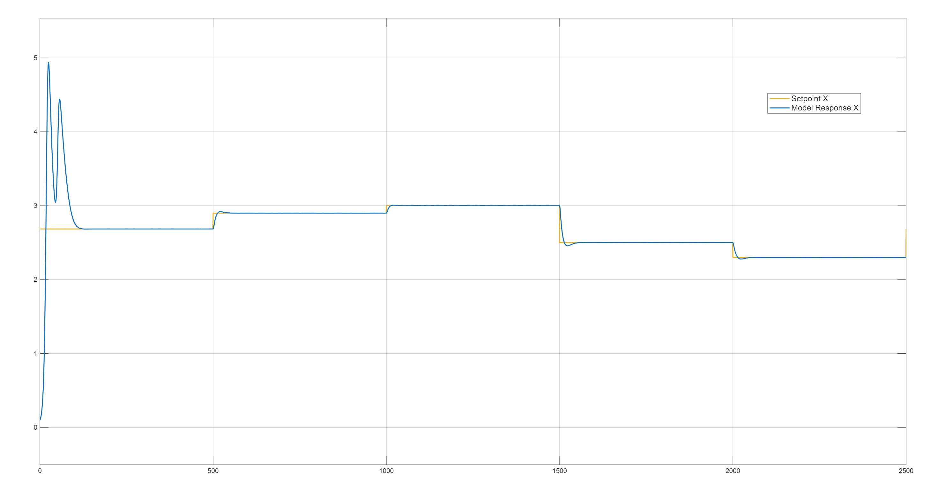
Set Point tracking-PI Controller

Slide 35
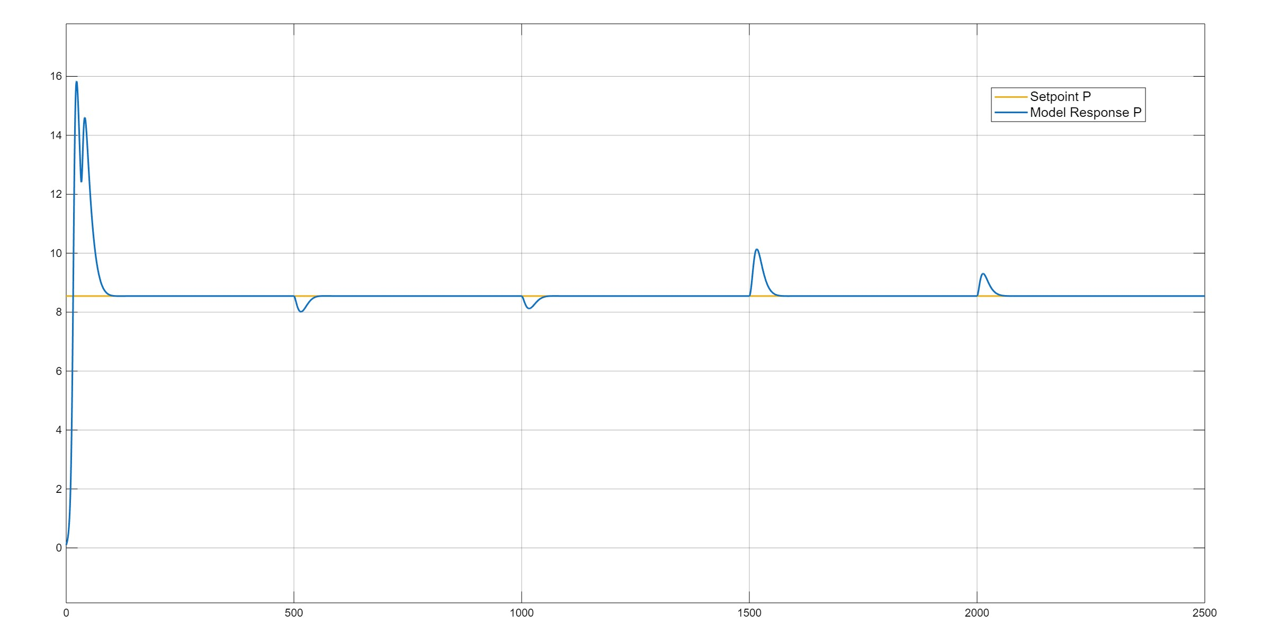
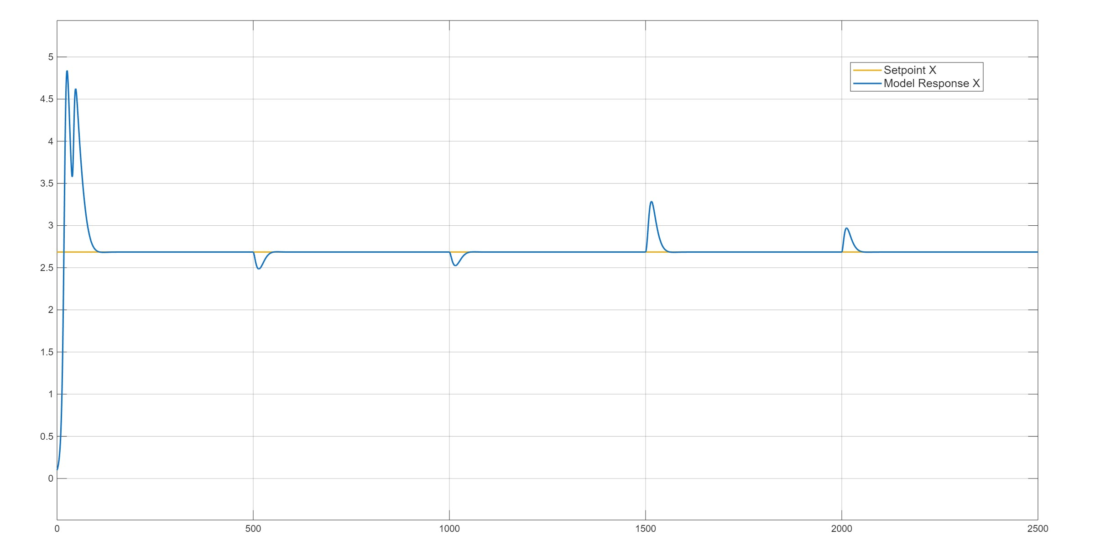
Regulatory-PID Controller

Slide 36
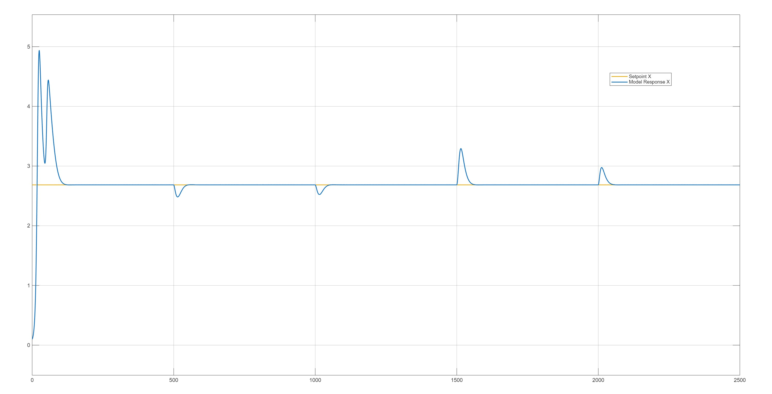
Regulatory-PI Controller ()

Slide 37
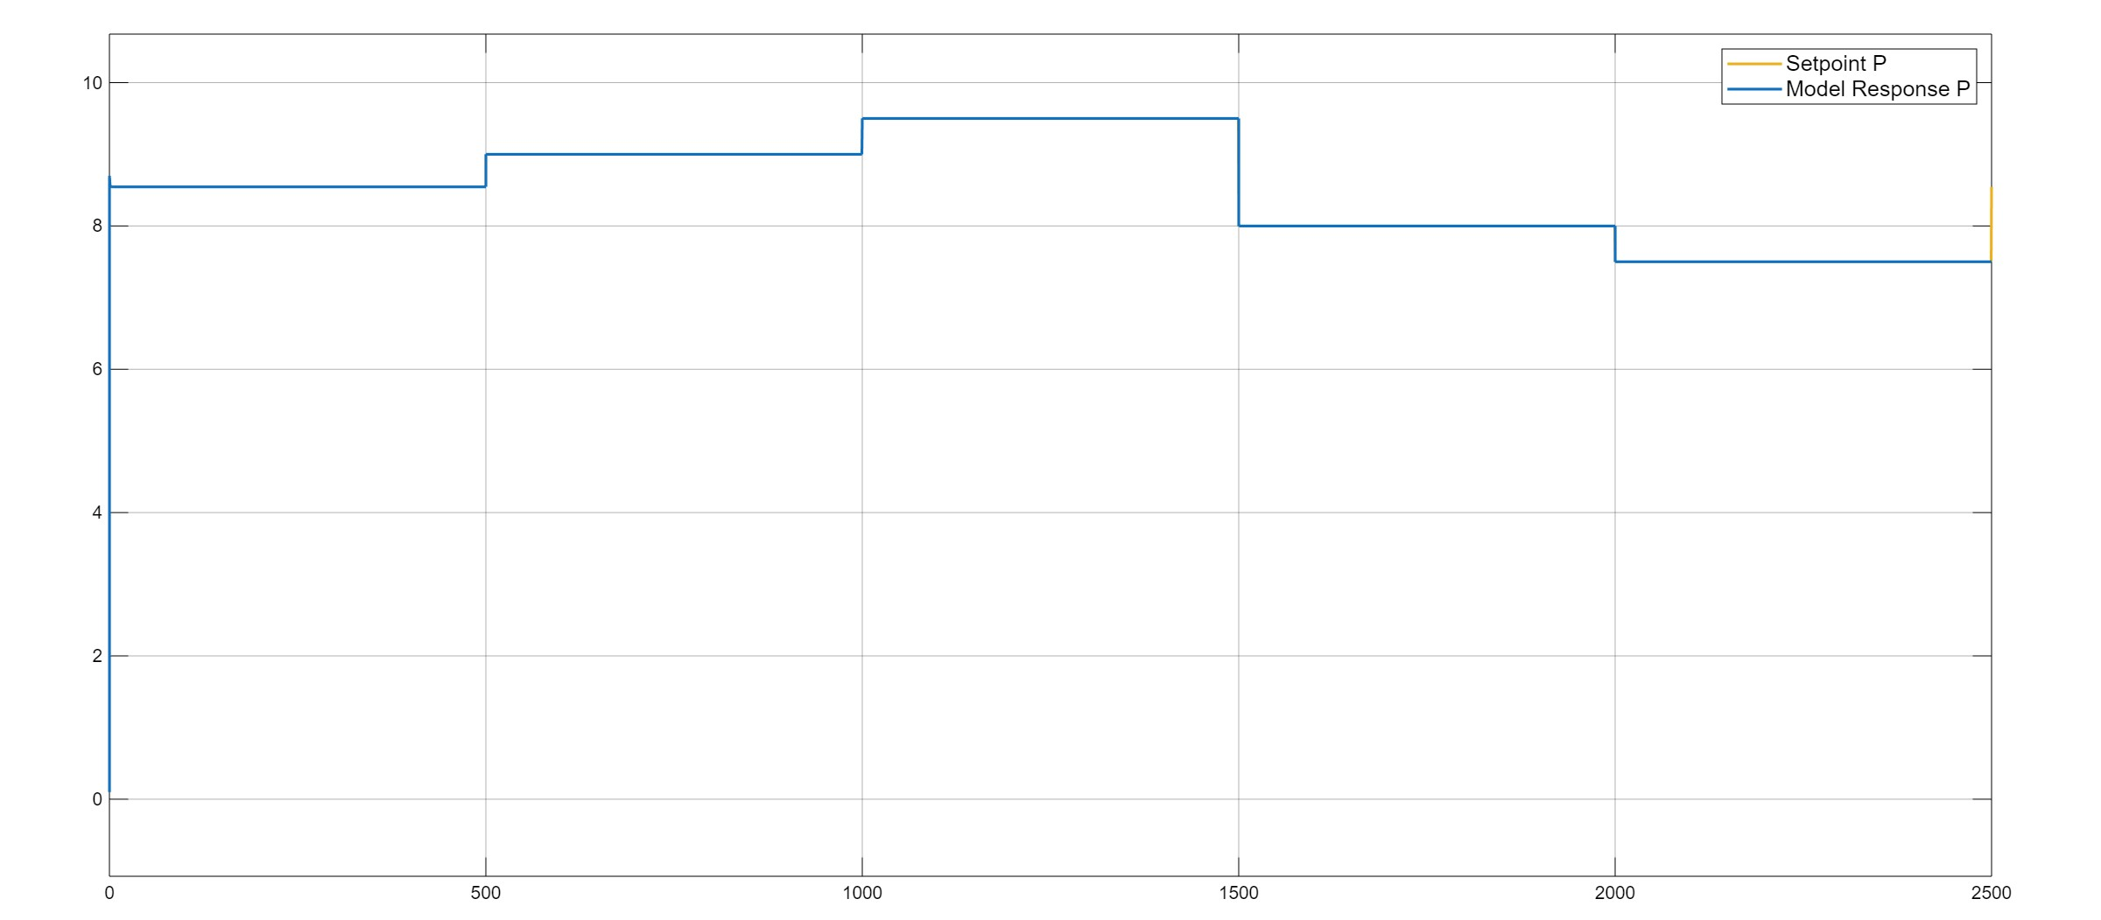
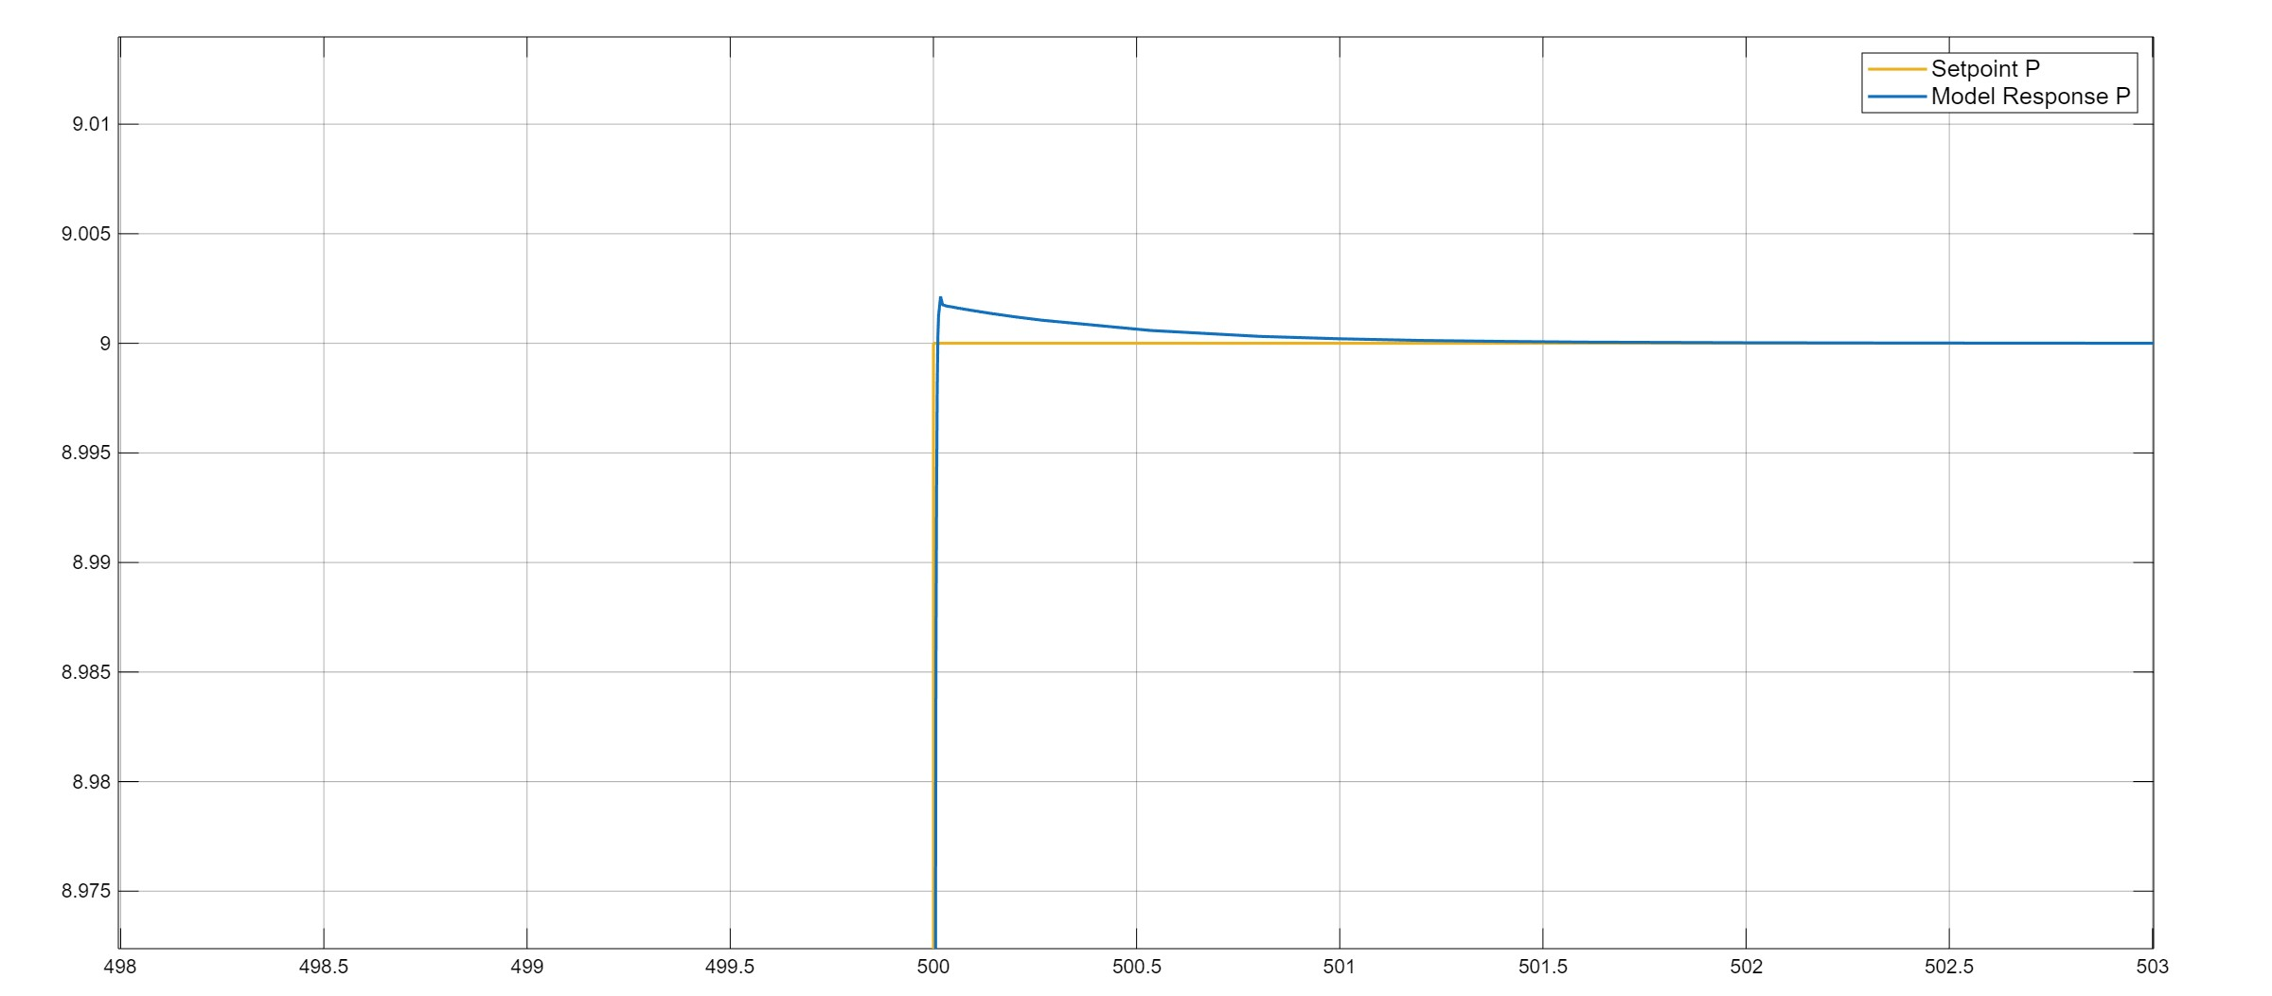
Auto Tuning (Servo problem)

Slide 38
Conclusion
We identified the controller parameters using the values obtained from model identification.
Our PI and PID controller works well.
We choose the value of TauD very less as its contribution is very less.
We also used auto tuning for servo problem and it gave response very quickly.

